Slide 1
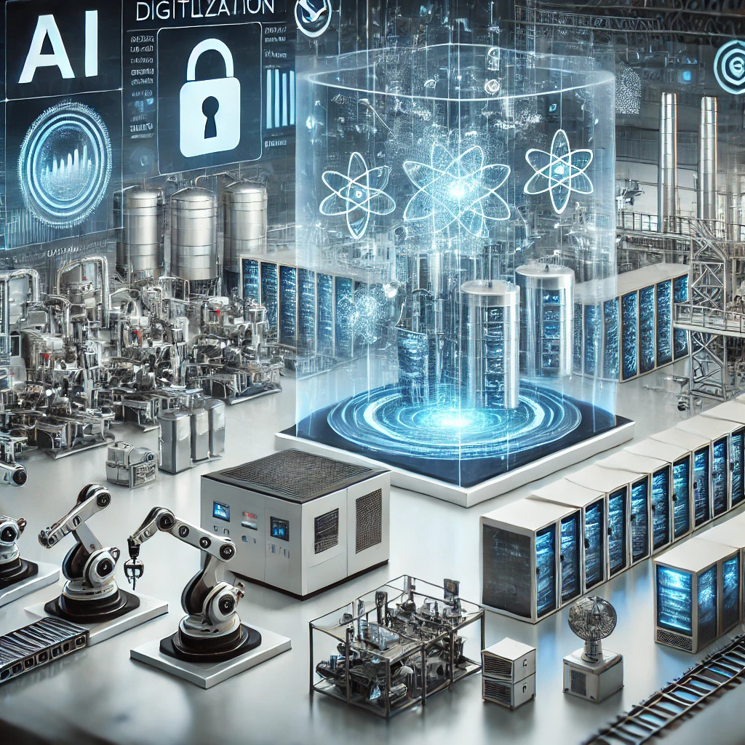
Digital Technologies
Software Engineering
Prof. Dr.-Ing. Sebastian Schlesinger
Professor of Business Computer Science
Cybersecurity and Embedded Systems Engineering

Slide 2
Goals of this lecture
Understand how software engineering is generally done, how systems are built
  Particularly some techniques for requirements engineering
Understand fundamental data structures, how and when they are applied

Slide 3
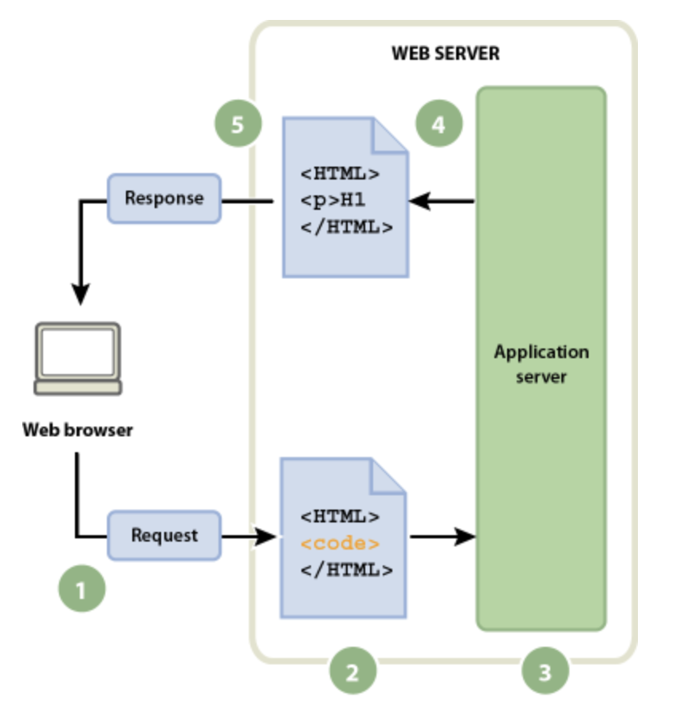
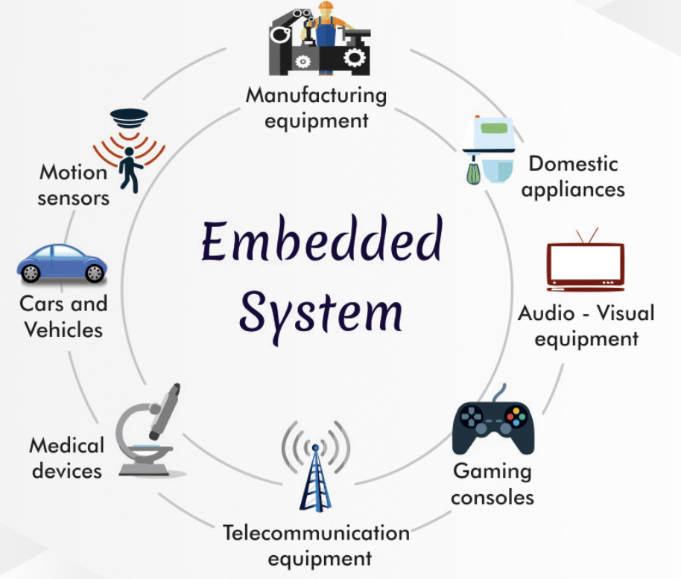
Two Worlds – Web Applications and Embedded Systems
98% of chips, often in safety-critical environments, Emphasis: Mean Time Between Failure (MTBF)
Emphasis: Mean Time To Repair (MTTR), scalability, resilience

Slide 4
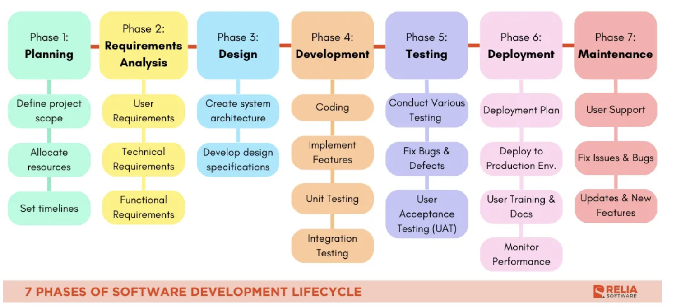
Software Development Lifecycle
Source: https://reliasoftware.com/blog/software-development-life-cycle-sdlc

Slide 5
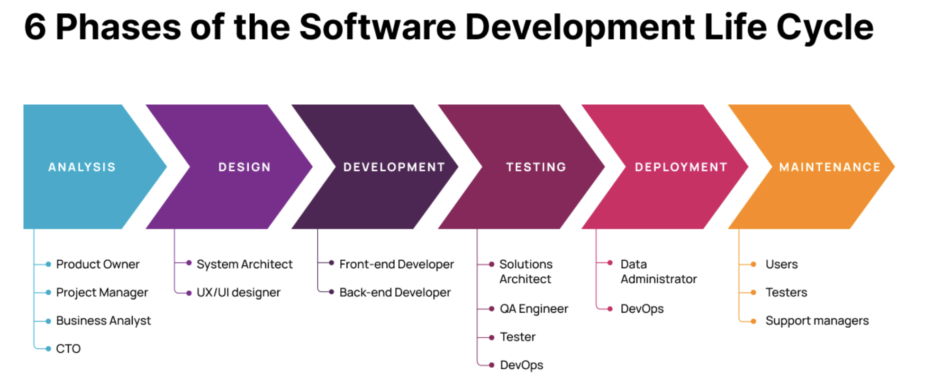
Software Development Lifecycle (SDLC)
Source: https://brocoders.com/blog/agile-software-development-life-cycle/

Slide 6
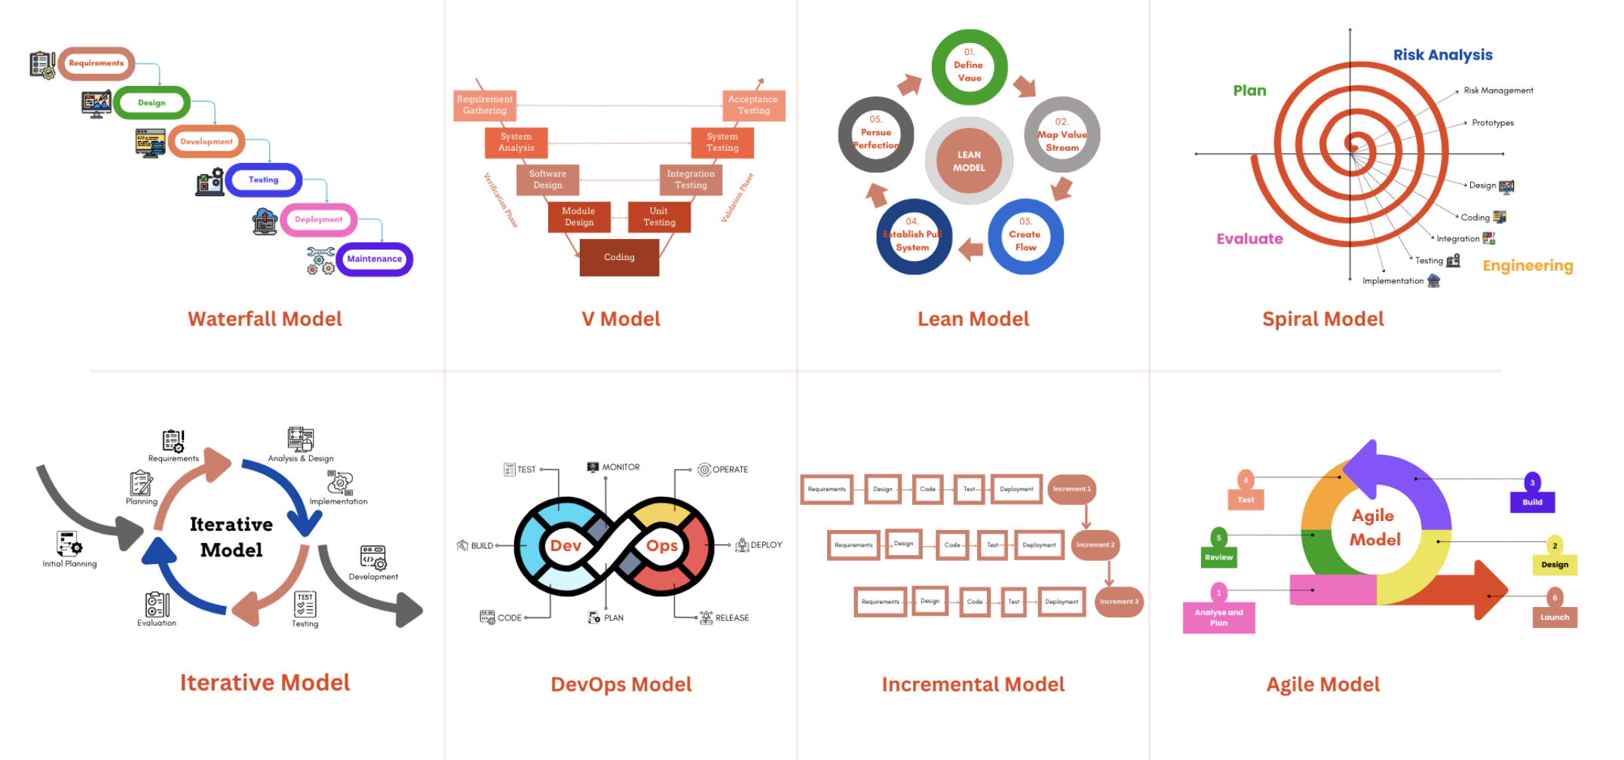
8 Models for SDLC
Source: https://reliasoftware.com/blog/software-development-life-cycle-sdlc

Slide 7
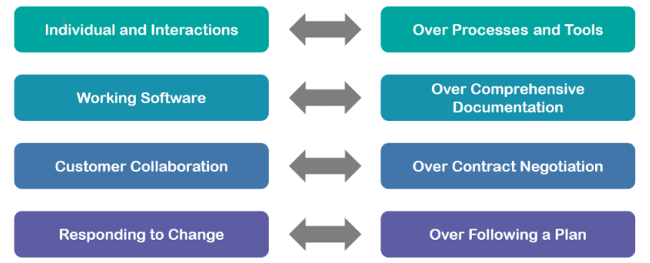
Agile Manifesto
Notes:
2001

Slide 8
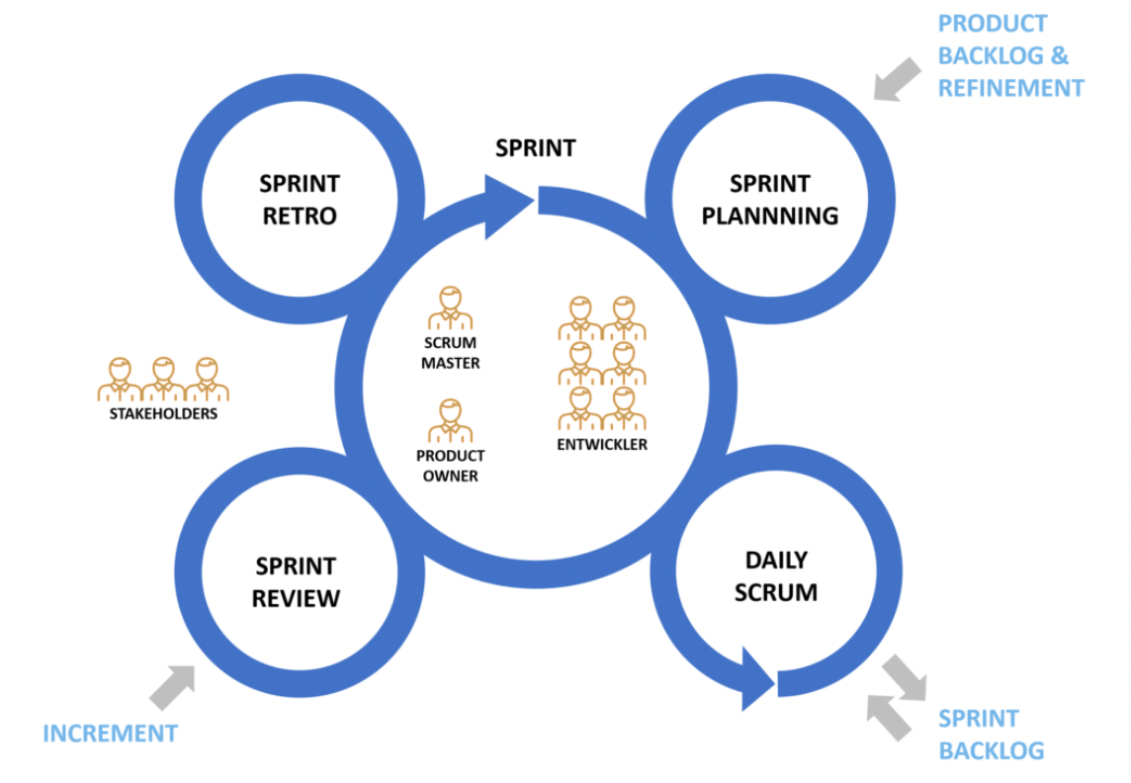
Scrum

Slide 9
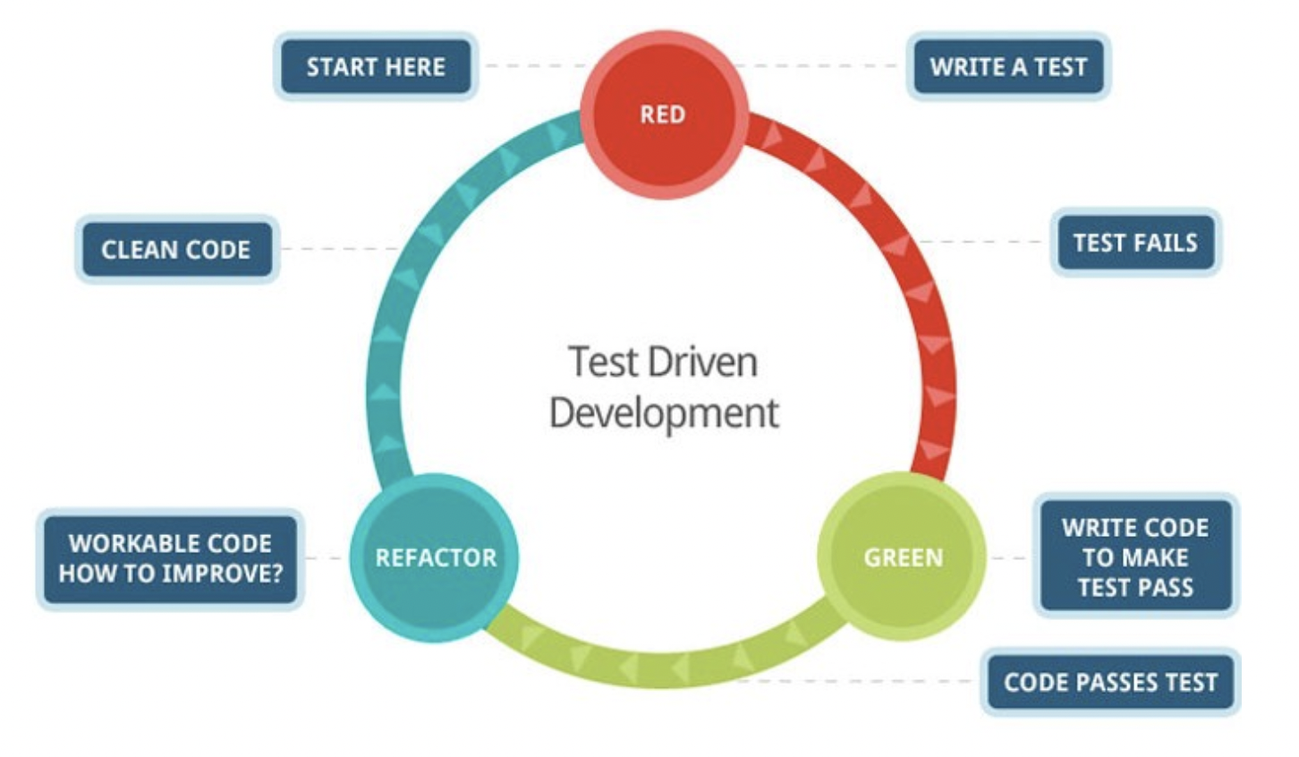
Test-Driven Development

Slide 10
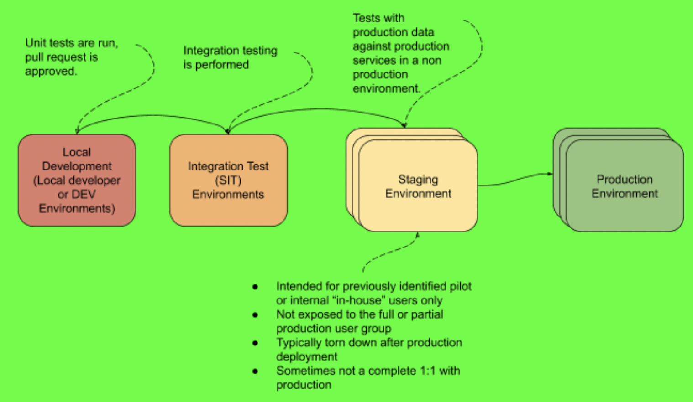
Staging und Production Environments

Slide 11
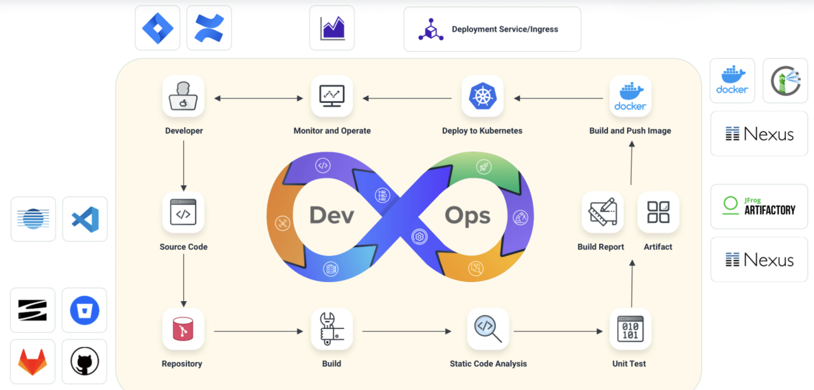
Continuous Integration, Continuous Deployment

Slide 12
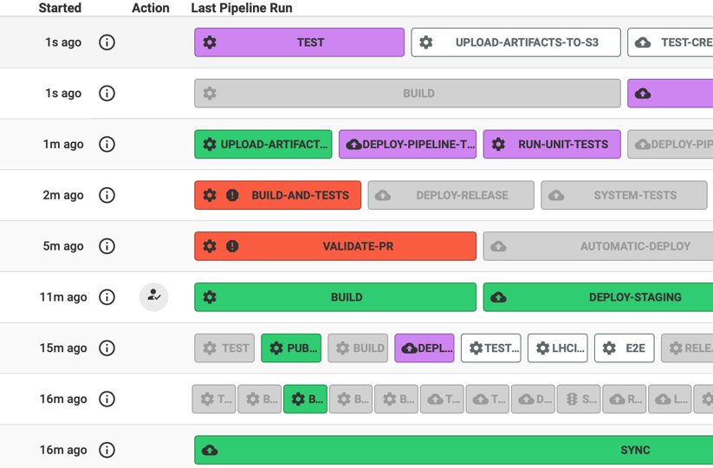
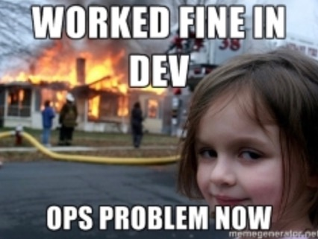
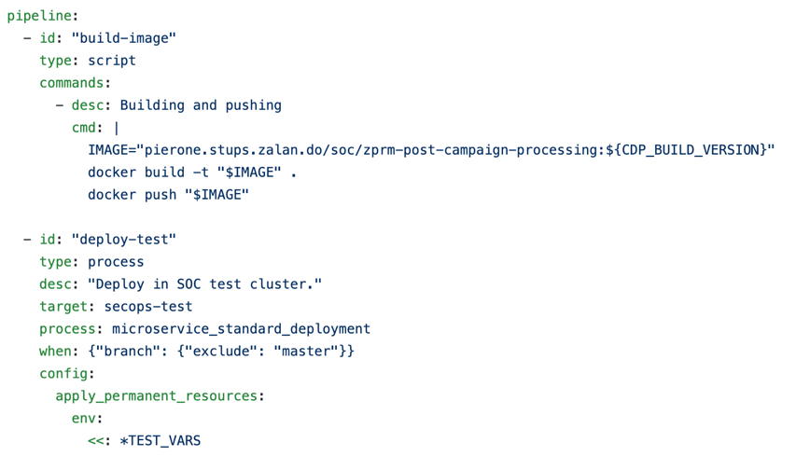
Continuous Integration, Continuous Deployment
Old World:
New World:
DevOps
„You build it, you run it.“ Werner Vogels, Amazon
Continuous Integration /
Continuous Delivery
Infrastructure as Code

Slide 13
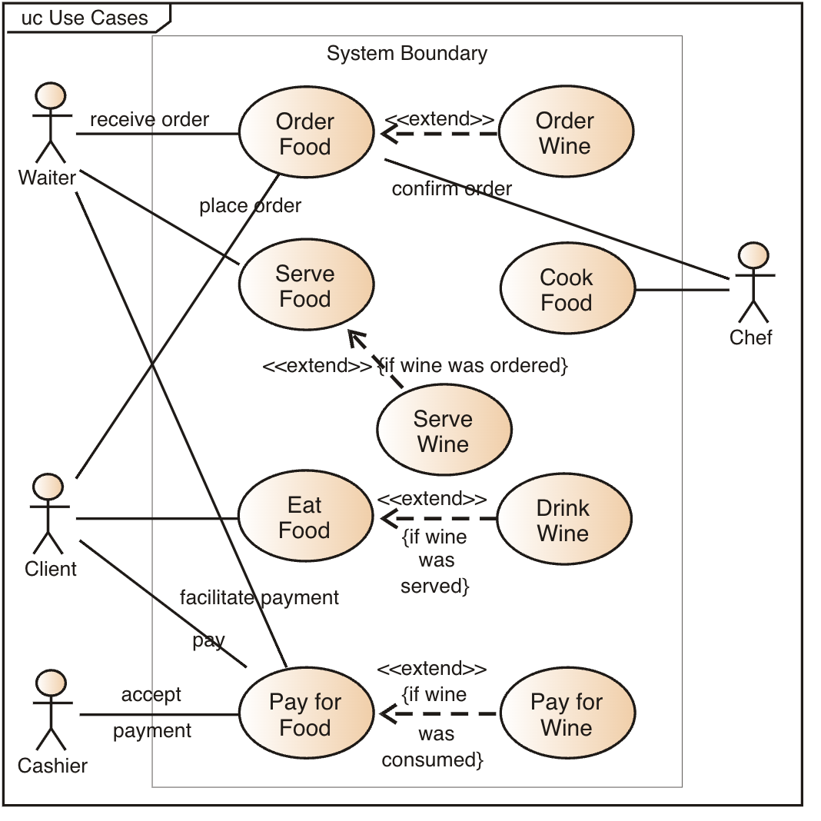
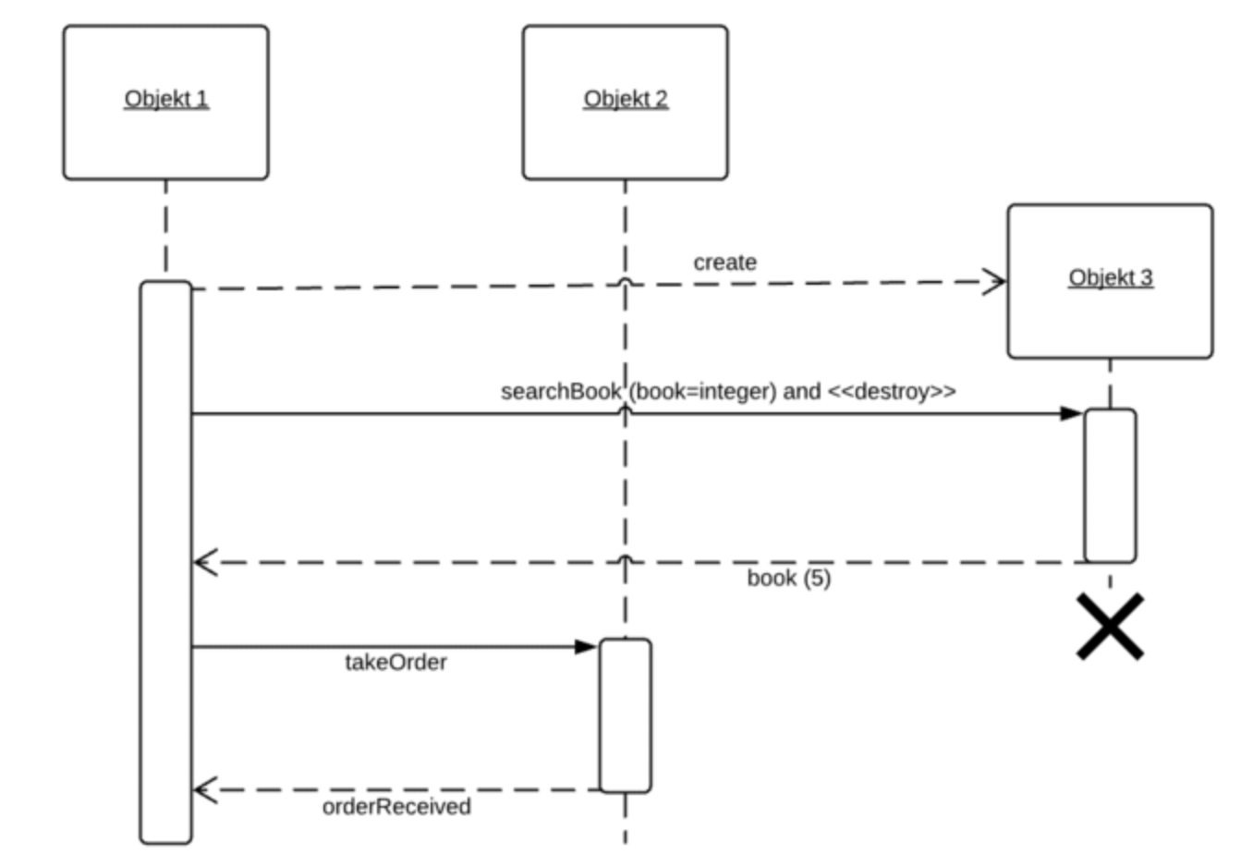
Requirements Engineering
Use Cases
Sequential Diagrams

Slide 14
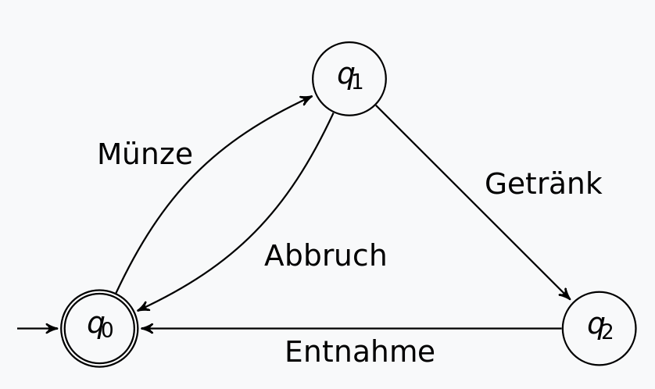
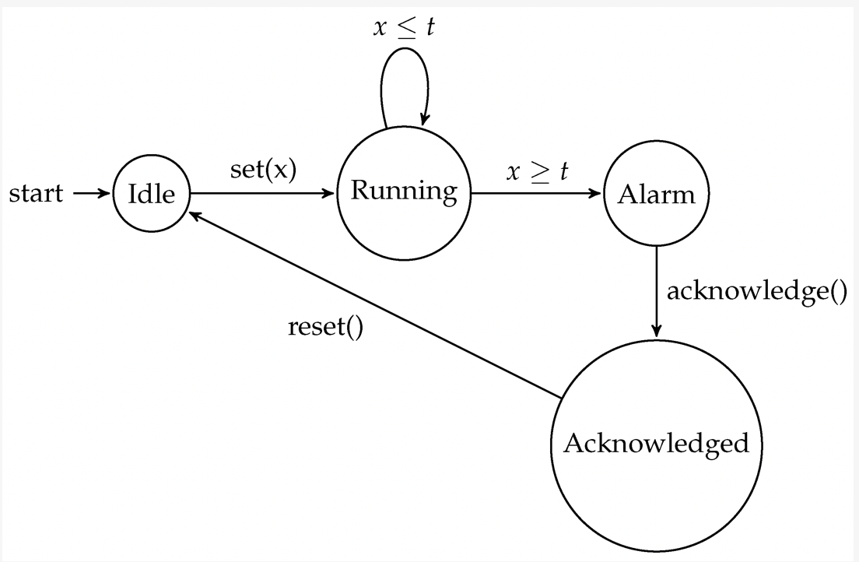
State of a System
Timed Automata

Slide 15
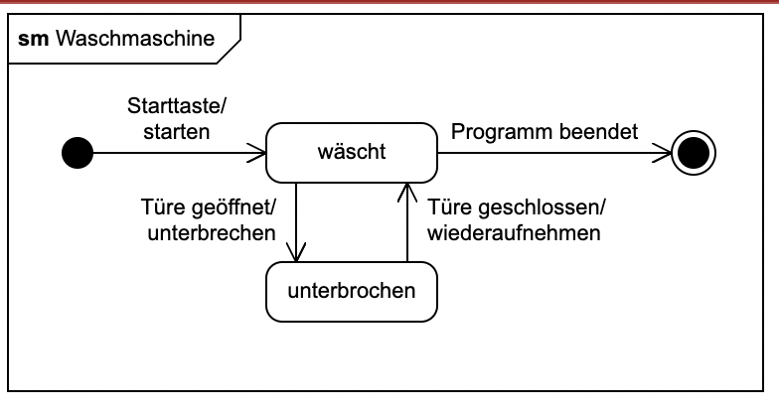
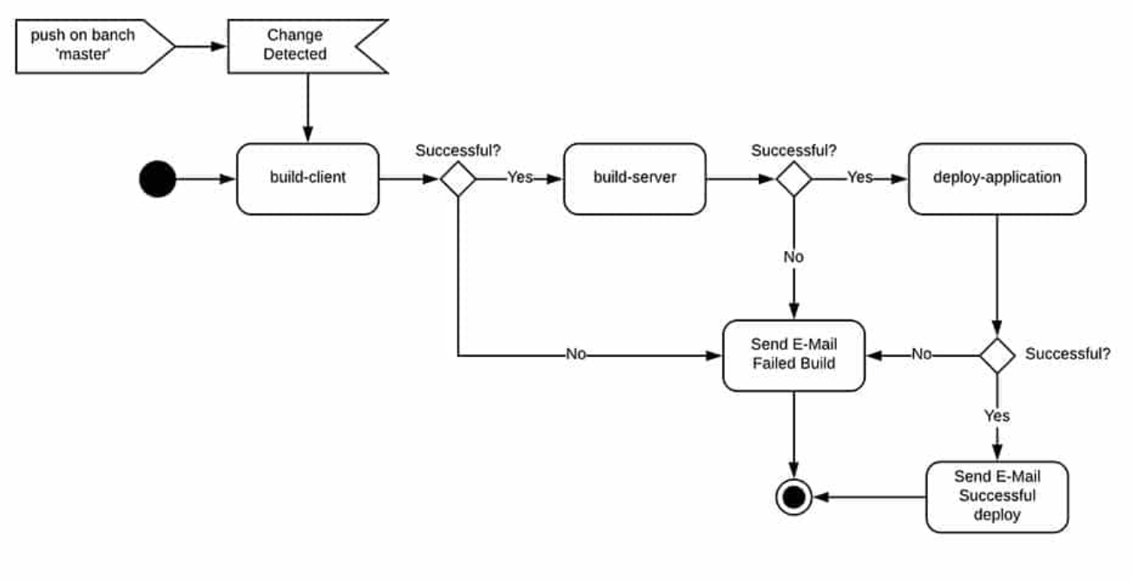
Requirements Engineering
State Charts
Activity Diagrams

Slide 16
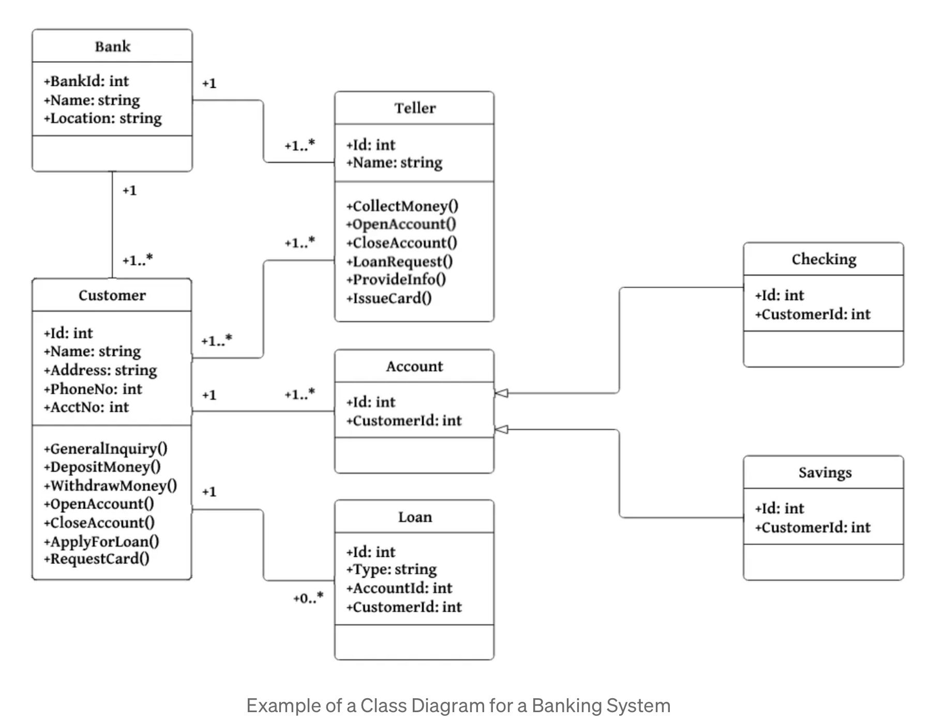
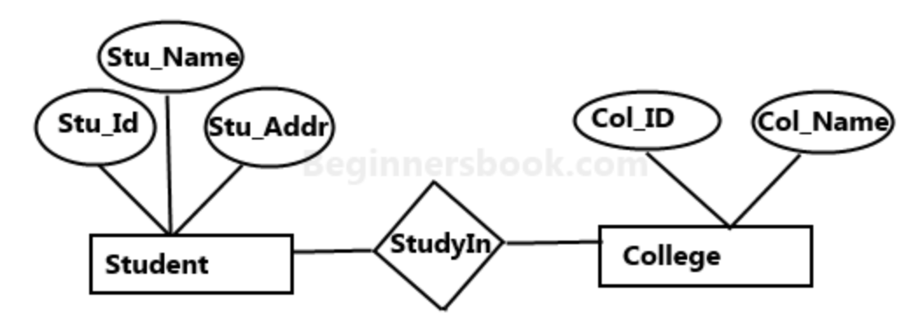
Requirements Engineering
Entity Relationship Model
UML Class Diagram
Source: https://medium.com/@smagid_allThings/uml-class-diagrams-tutorial-step-by-step-520fd83b300b

Slide 17
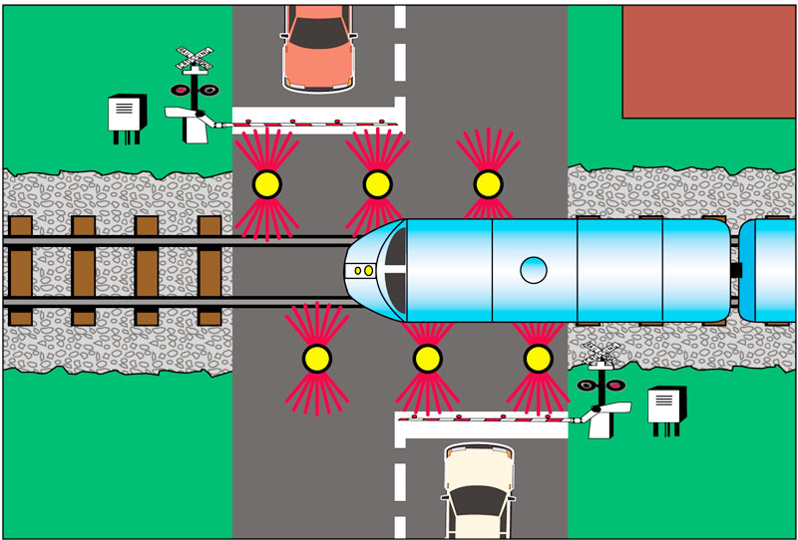
Example
Street crossing a train track
three components:
  train
  gate
  controller

Slide 18
Example
Train sends signal (approach) at least two time steps before the train reaches the crossing to the controller and stays at most three time steps in the crossing, then sends exit signal
t₀
approach!, x := 0
t₁
exit!
TRAIN
x >= 2, in, x := 0
t₃
x ≤ 3
t₂
x ≤ 3
out

Slide 19
Example
Gate opens and closes when signals are received
Gate takes at most one time step for closing, 1-2 for opening
g₀
lower?, y := 0
g₁
y ≤ 1
y ≥ 1, up
GATE
down!
g₃
y ≤ 2
g₂
raise?, y := 0

Slide 20
Example
Controller sends 1 time step the command lower after having received signal approach to gate and command raise after at most 1 time step of receiving exit
c₀
approach?, z := 0
c₁
z ≤ 1
raise!
CONTROLLER
z = 1, lower!
c₃
z ≤ 1
c₂
exit?, z:= 0

Slide 21
Example
t₀
approach!, x := 0
t₁
g₀
lower?, y := 0
g₁
y ≤ 1
x >= 2,
in!,
x := 0
y ≥ 1,
up!
exit!
TRAIN
GATE
down!
t₃
x ≤ 3
t₂
x ≤ 3
g₃
y ≤ 2
g₂
out!
raise?, y := 0
c₀
approach?, z := 0
c₁
z ≤ 1
raise!
CONTROLLER
z = 1, lower!
c₃
z ≤ 1
c₂
exit?, z:= 0

Slide 22
Exercises
Split in 5 groups
Each chooses one of the following exercises and tries to solve it

Slide 23
Exercise 1
Task 1: Traffic Light Controller
Design a timed automaton that models the behavior of a simple traffic light for cars at a junction.
The traffic light has four main phases:
  Red, Red-Yellow, Green, Yellow.
Each phase lasts a specific amount of time:
  Red: 10 seconds
  Red-Yellow: 2 seconds
  Green: 15 seconds
  Yellow: 3 seconds
Tasks:
Define the set of states, transitions, and clock variables.
(Hint: You can use one clock x that resets at each transition.)
Specify the guards and invariants for each state:
e.g. transition Red → Red-Yellow when x ≥ 10.

Slide 24
Exercise 2
Task 2: Elevator Door Controller
Model the behavior of an elevator door that opens and closes automatically after a delay.
The door has the following main states:
Closed
Opening
Open
Closing
Tasks:
Define a timed automaton with:
A clock variable x that measures time within each state.
Transitions triggered by conditions on x and external events.
Include the following behavior:
Opening takes 3 seconds → transition Opening → Open when x ≥ 3.
The door remains open for 10 seconds → Open → Closing when x ≥ 10.
Closing takes 3 seconds → Closing → Closed when x ≥ 3.

Slide 25
Exercise 3
Task 3: Library System (UML Class Diagram)
Design a class diagram for a small library management system.
The system manages books, users, and loans.
Tasks:
Identify the main classes:
Library, Book, Copy, User, Loan
Define meaningful attributes (e.g. title, author, dueDate) and operations (e.g. borrow(), return()).
Specify relationships and multiplicities:
  A Library manages many Books.
  A Book can have several Copies.
  A User can have multiple Loans, each linked to a single Copy.

Slide 26
Exercise 4
Task 4: Online Shop (UML Class Diagram)
Model a simplified online shopping system.
The system handles products, customers, orders, and payments.
Tasks:
Identify key classes:
Product, Customer, Order, OrderItem, Payment, Shipment
Specify relationships:
An Order is composed of several OrderItems.
Each OrderItem refers to one Product.
A Customer can place multiple Orders.
Add a payment hierarchy:
Abstract class Payment
→ Subclasses: CreditCardPayment, PayPalPayment, InvoicePayment.
Add useful attributes and methods (e.g. calculateTotal(), confirmPayment()).

Slide 27
Exercise 5
Task 5: Coffee Machine (Combining Structural & Behavioral Models)
Model a coffee vending machine that allows a user to select a drink, pay, and receive the coffee.
Tasks:
Create a Statechart Diagram describing the system’s behavior:
States: Idle, Selection, Payment, Brewing, Dispensing, Error
Events: button pressed, payment completed, coffee ready, error detected.
Create a Class Diagram describing the system’s structure:
CoffeeMachine, UserInterface, PaymentModule, BrewingUnit, Sensor
Indicate how objects collaborate:
e.g. UserInterface sends commands to PaymentModule.
BrewingUnit reports status to the controller.
(Optional) Draw a Sequence Diagram showing the flow for one coffee purchase.

Slide 28
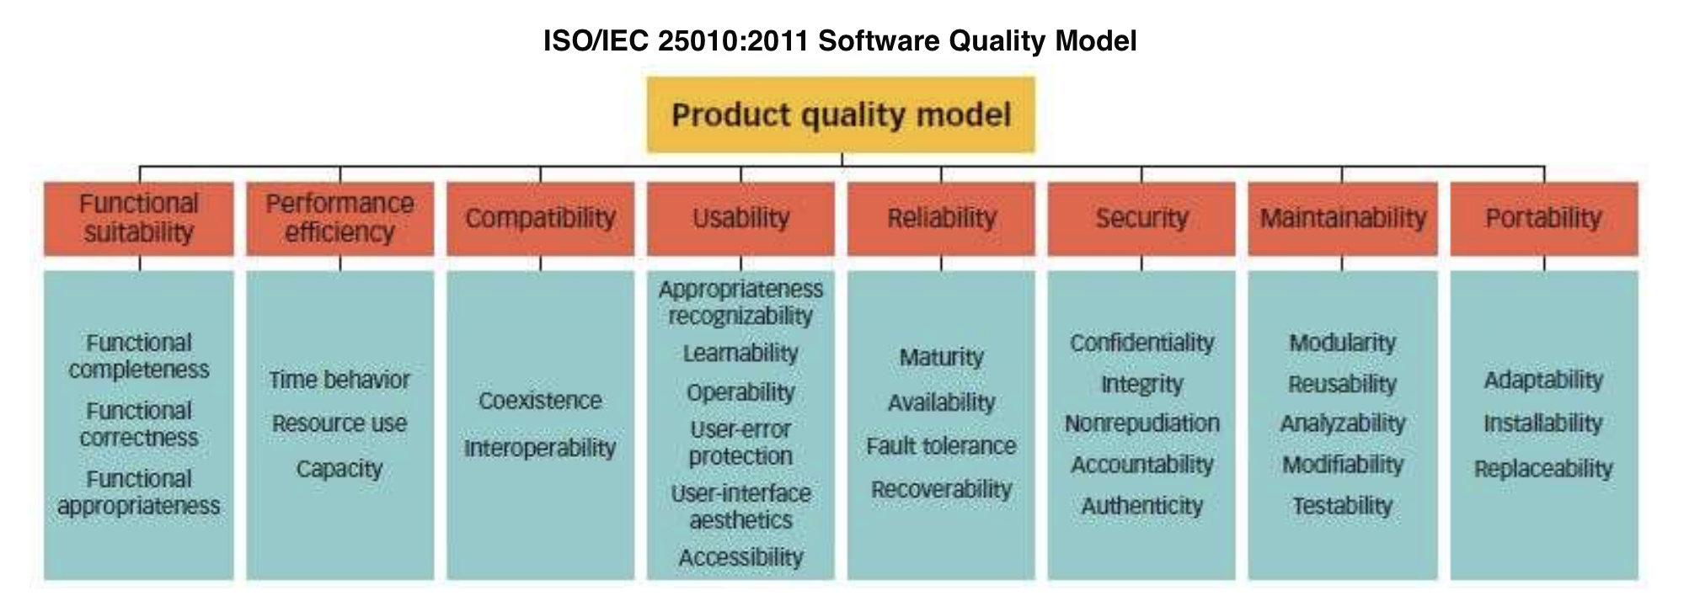
Requirements Engineering
Software Quality
Source: https://asq.org/quality-resources/software-quality?srsltid=AfmBOooQA2b0lzfMKqED4y6G_hTpkSs_kgfZcIsdJ8J-b76lgh54_2m_

Slide 29
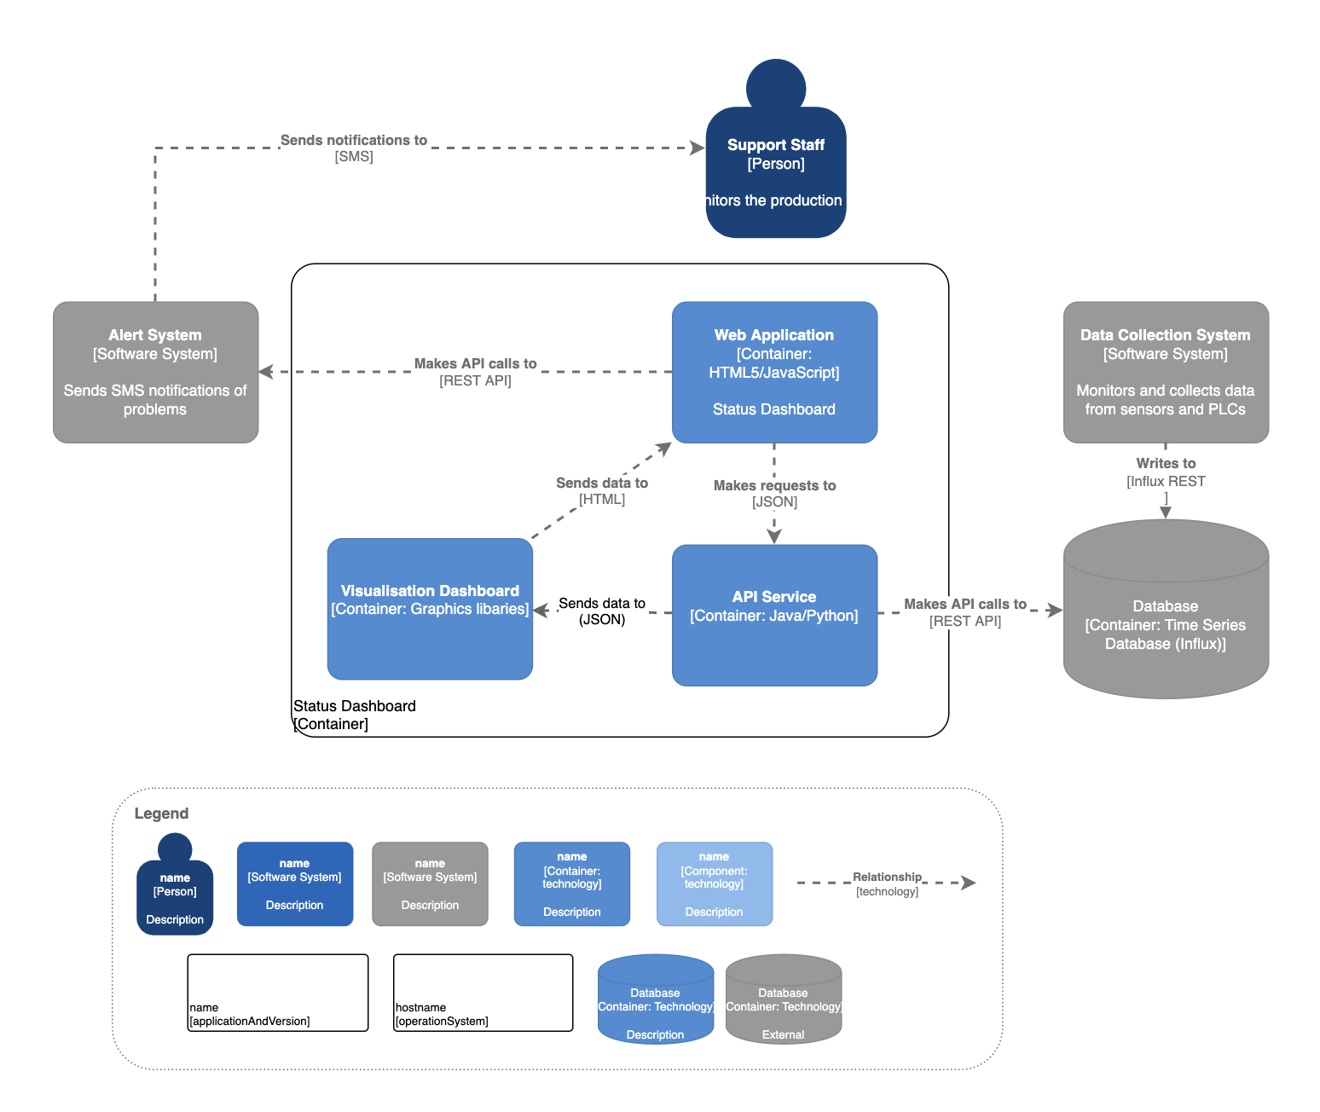
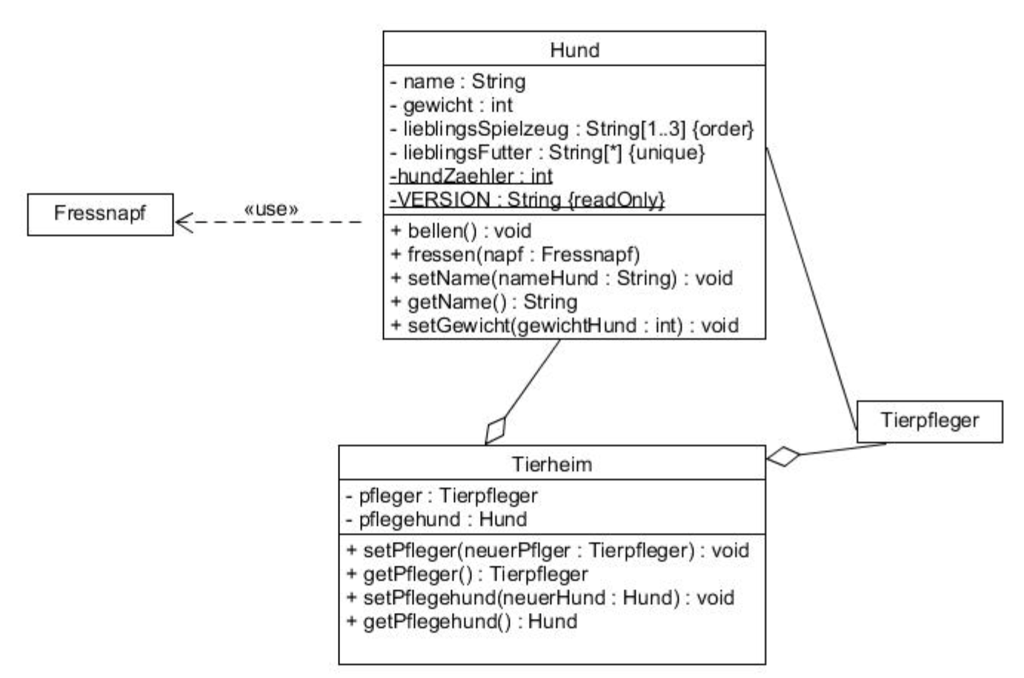
Architecture
System Architecture
Class Diagram

Slide 30
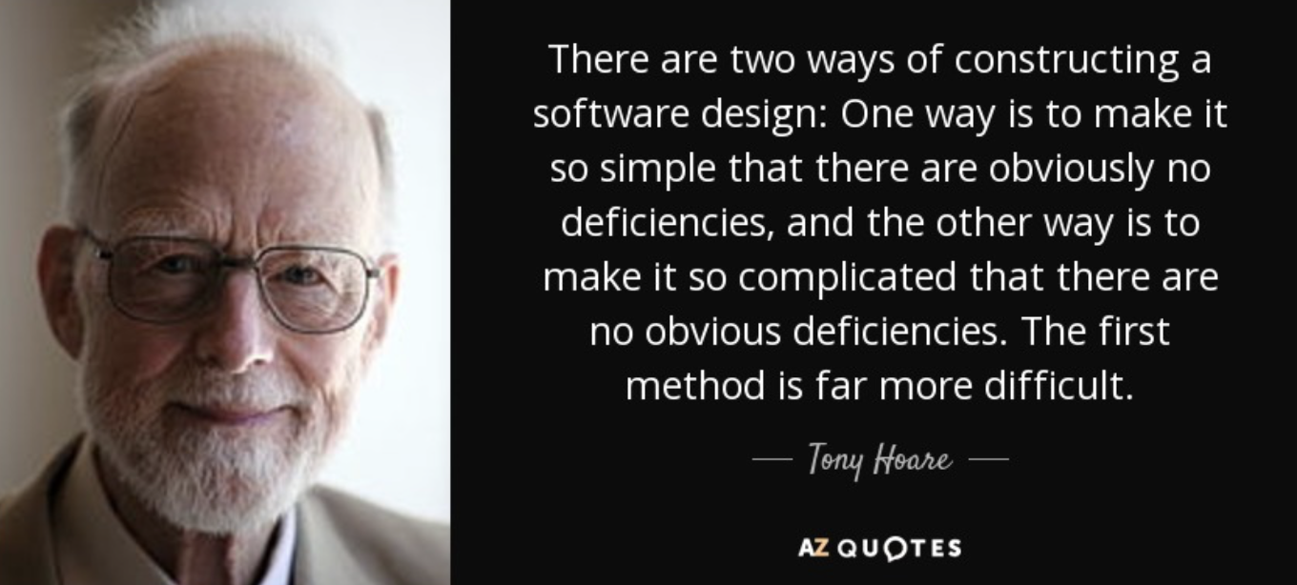
Software Engineering is diffcult

Slide 31
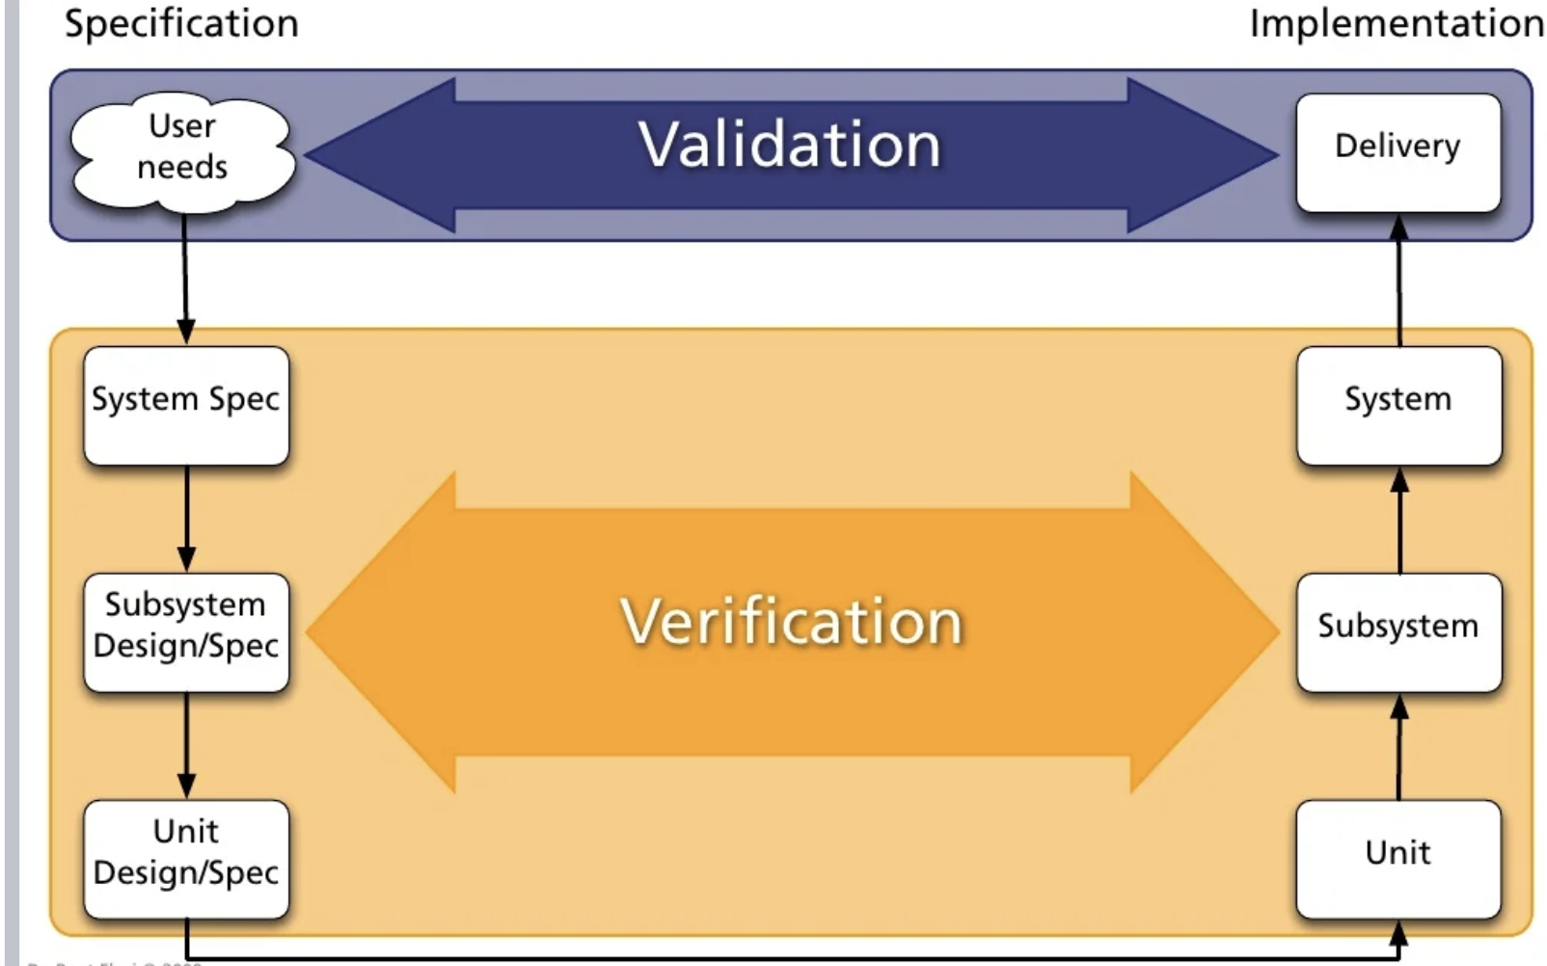
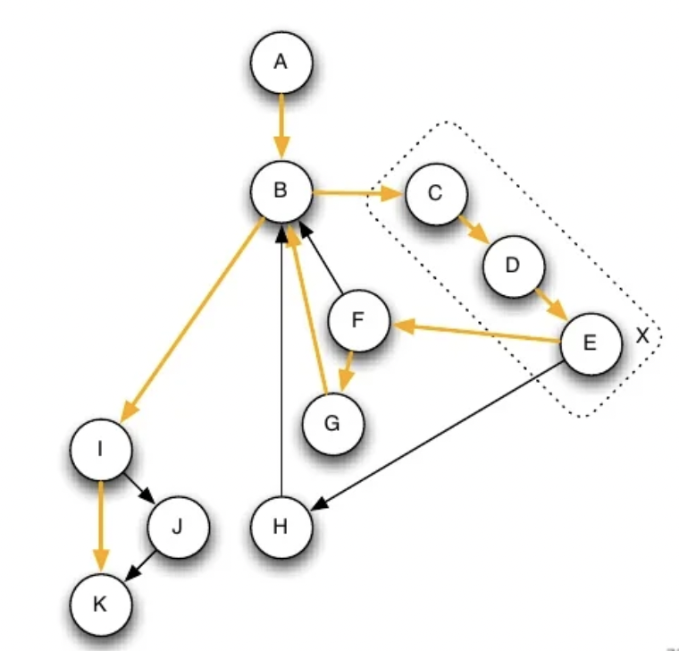
Verification and Validation
State Space Coverage

Slide 32
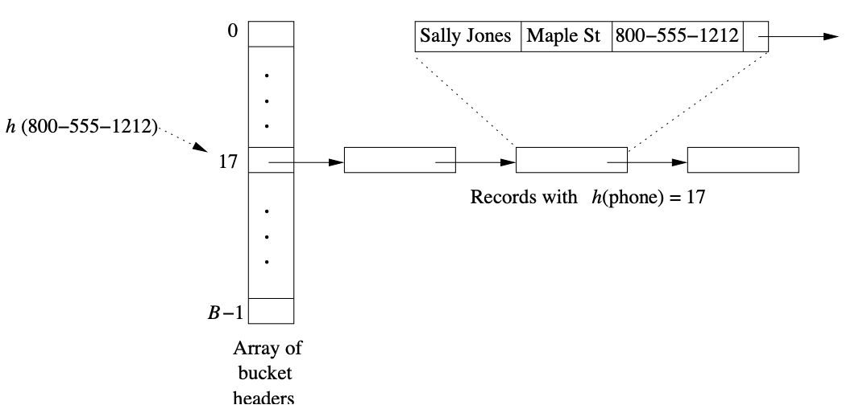
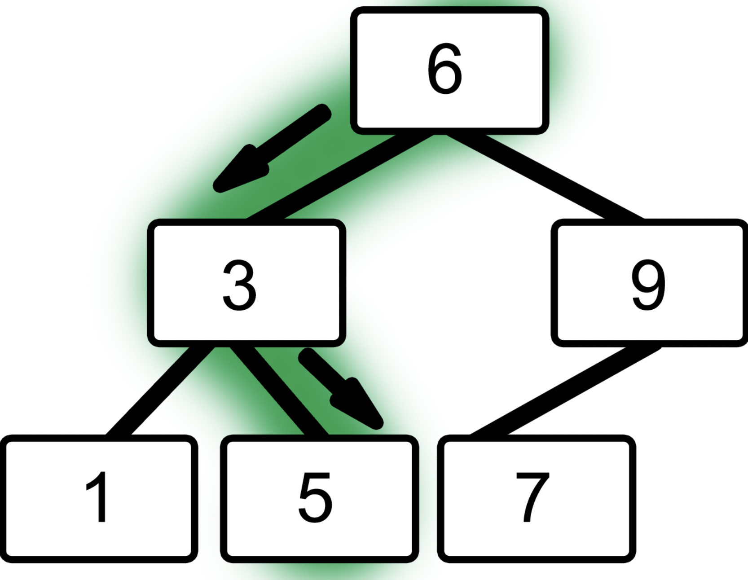
Data Structures
Hashmaps
Trees

Slide 33
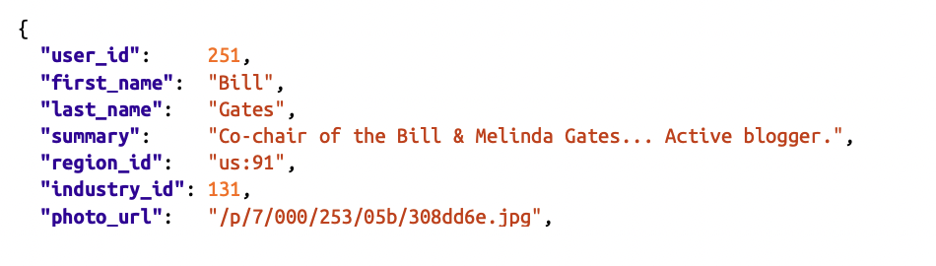
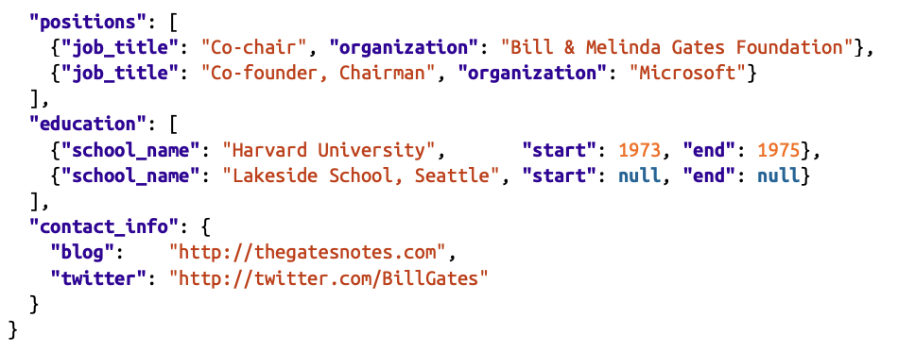
Structural Data Representation - JSON

Slide 34
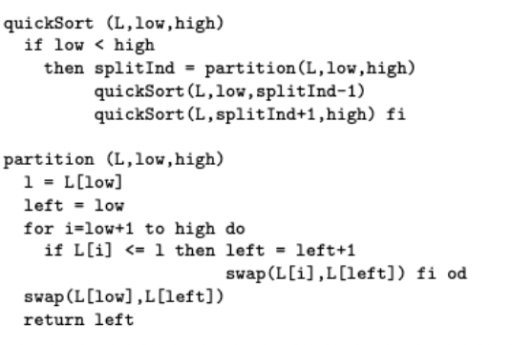
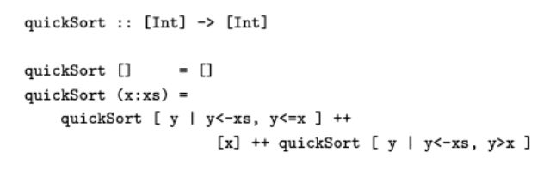
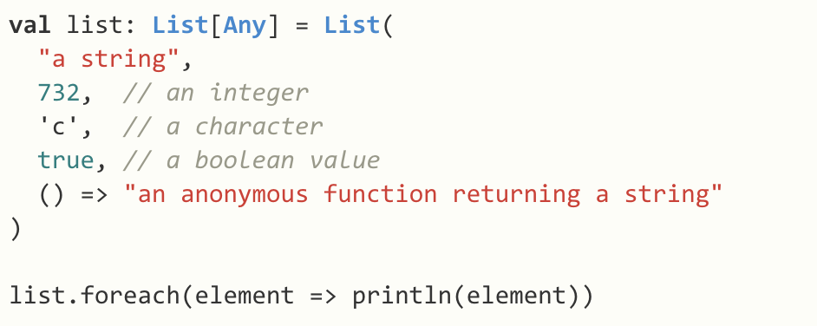
Programming Languages - Paradigms
procedural
object-oriented
functional
logical

Slide 35
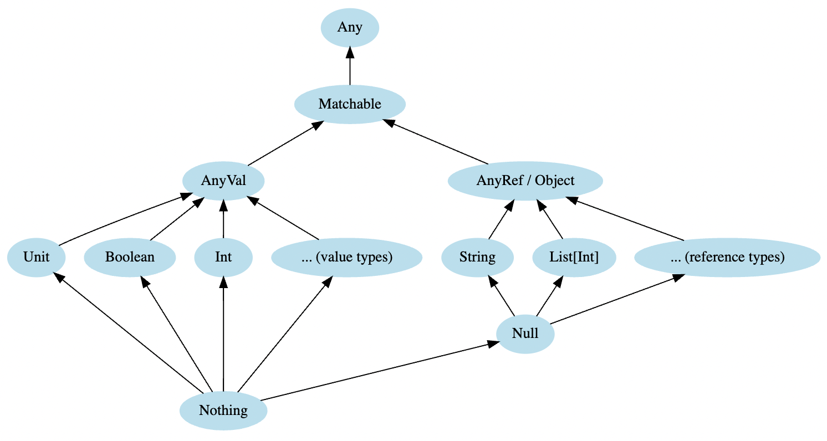
Types in Programming Languages

Slide 36
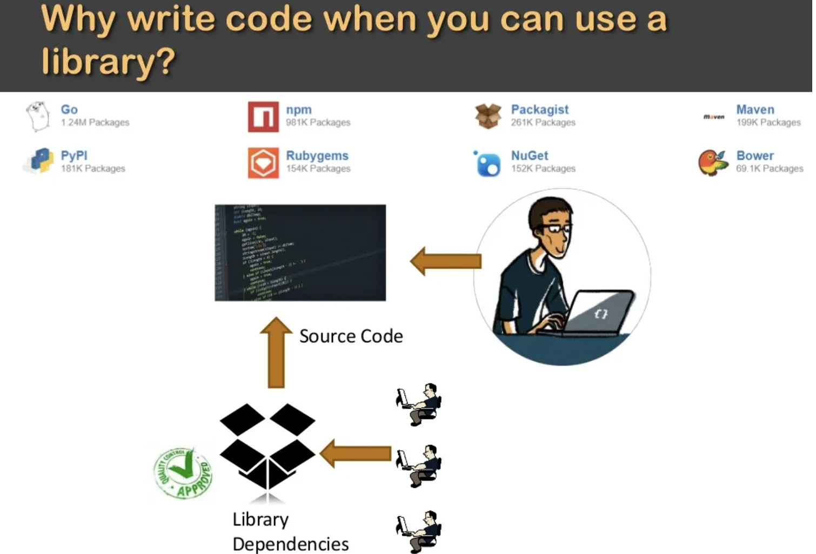
Software Dependencies
Two Main Types:
External: Libraries
Internal: Dependencies between classes / modules etc.

Slide 37
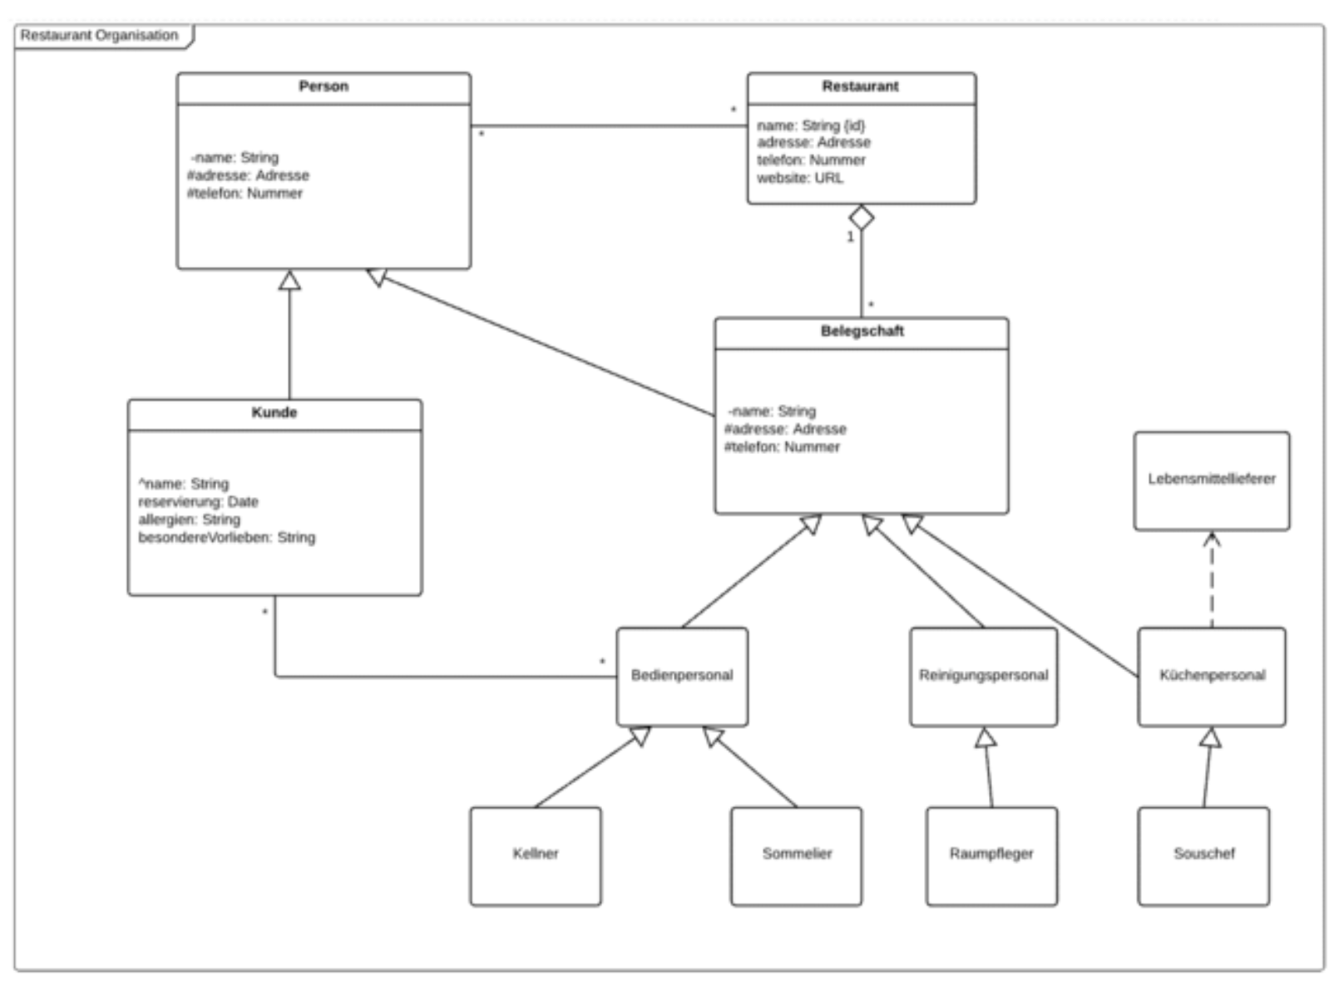
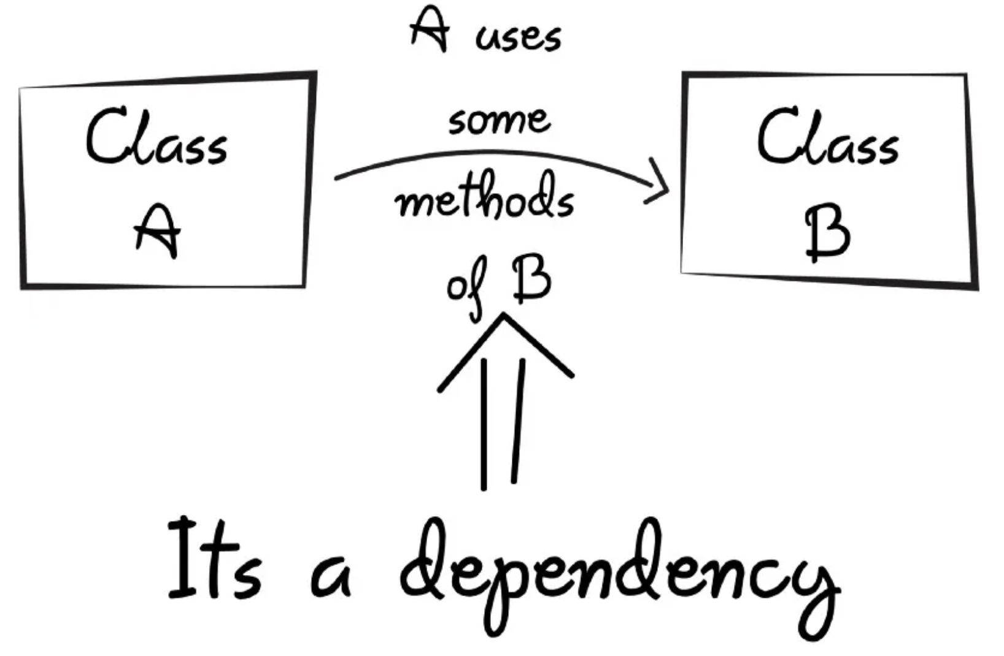
Software Dependencies
Internal Dependencies

Slide 38
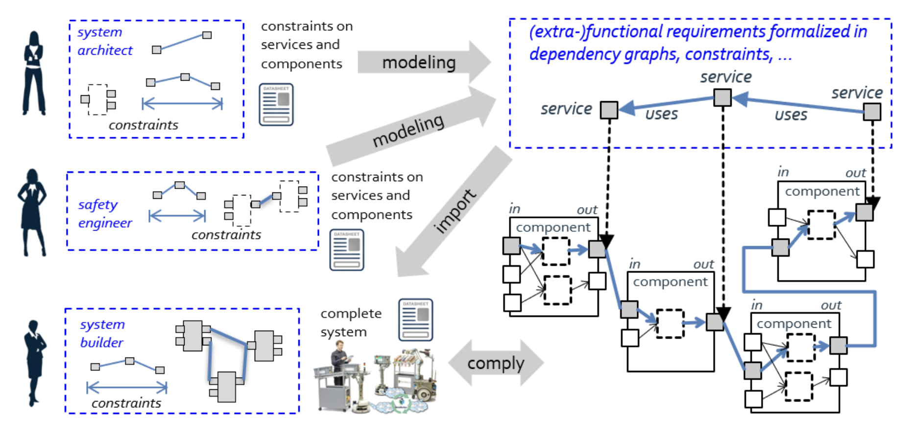
Dependencies are everywhere – System Engineering is difficult
Quelle: https://robmosys.eu/wiki/composition:dependency-graphs:start

Slide 39
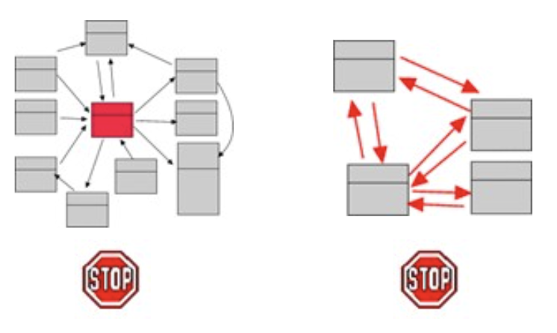
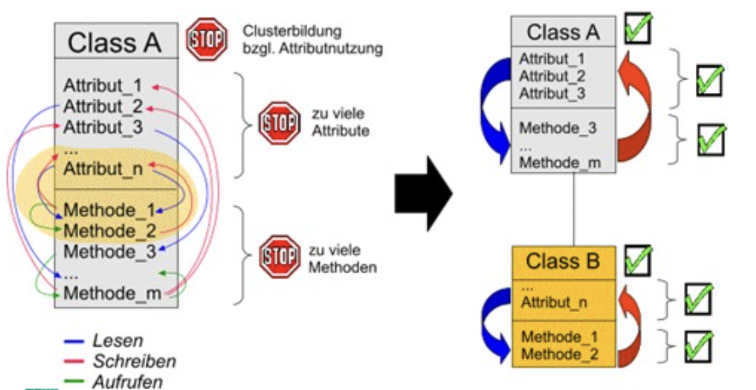
Managing complexity: Modularisation, Encapsulation
Quelle: https://slideplayer.org/slide/660759/

